Slide 1


DUBLIN
Bob Duffy @bob_duffy
Secrets of Azure storage and SQL
(IaaS)
Lets trend! … #GlobalAzure

Slide 2

Bob Duffy
22 years in database sector, 250+ projects
SQL Server MCA, MCM, MVP
SSAS Maestro
Senior Data Platform Consultant with Microsoft 2005-2008
Database Architect at Prodata SQL Centre of Excellence
http://blogs.prodata.ie/author/bob.aspx
bob@prodata.ie

Slide 3
Agenda
Azure Storage Overview
The Five Steps to Iaas Storage
1. SQL Capacity Planning
2. Selecting your VM
3. Selecting your disks
4. Configure your disks
5. Benchmarking
Abusing the rules

Slide 4
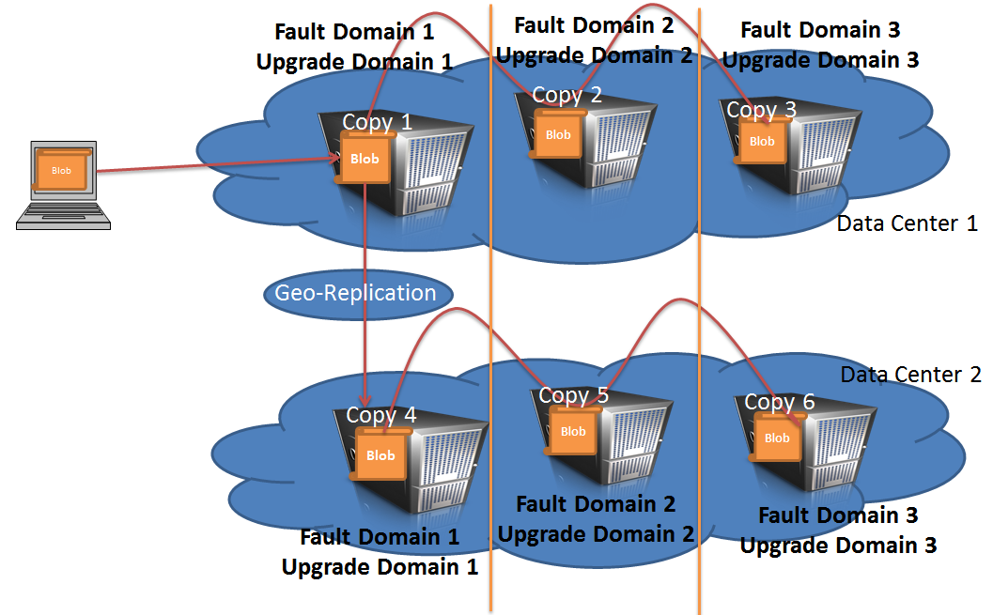
Azure Storage Overview
Geo redundancy/replication
 | LRS | ZRS | GRS | RA-GRS
Total Copies | 3 | 3 | 6 | 6
SLA | 99.9% | 99.9% | 99.9% | 99.99% read 99.9% write
Takeaways:
Dont worry about RAID 1+
Dont do geo-replication for SQL IaaS
Write penalty (expect WRITE_LOG)
Warning: No write ordering on geo replication (Yet!)

Slide 5
1. Requirements
4. Configure Disks
3. Select Disks
1. Requirements
5. Benchmark
2. Select VM
Aka Capacity Planning
Know your IOPS and Throughput
Know your RW%
Know your components (Data/Log/TempDB)
Know your Workload
(DWH v OLTP)

Slide 6
The Magnificent Seven Capacity Planning Metrics
Metric | Perfmon | dm_io_virtual_file_stats
IOPS | Logical Disk\Reads/Sec Logical Disk\Writes/Sec | Y
OLTP, DW, Mixed | Logical Disk\ Avg Disk Bytes/Read | Derived
Throughput | Logical Disk\Read Bytes/Sec | Y
Size of data, log, tempdb | MSSQL$:Databases(x)\Data File Size (KB) MSSQL$:Databases(x)\Log File Size (KB) | Y
% of workload in temp | Derived | Y
RW Ratio | Derived | Y
Latency | Logical Disk\Avg Disk Secs/Read | Y
[sys].[dm_io_virtual_file_stats]
https://sqlperformance.com/2013/10/t-sql-queries/io-latency

Slide 7





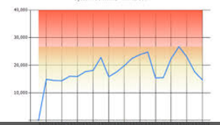
Capacity Planning Tools for Perfmon
Tools to capture metrics
Tools to analyse metrics
https://pal.codeplex.com/
https://blogs.msdn.microsoft.com/analysisservices/2011/06/14/analyzing-performance-data-in-powerpivot/

Slide 8
IOPS v Throughout
IOPS * IO Size = Throughput
500 iops @8k = 4MB/sec
500 iops @64k = 31MB/sec
500 iops @256= 125 MB/Sec
500 iops @4MB= 2 GB/Sec

Slide 9
SQL IO Characteristics (Avg IO Size)
Workload | Type | IO Size
Log Writes | Sequential | Up to 60k
Checkpoint | Random | Up to 256k
Table Scan | Sequential | 64-512K (on EE)
Index Seek | Random | 8k 64k (read ahead)
Backup | Sequential | 64k-4MB

Slide 10
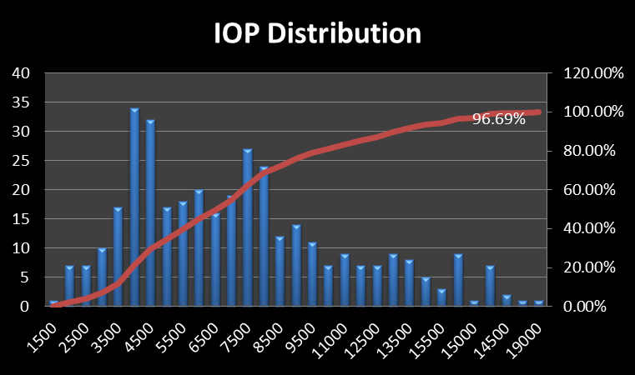
Analysing IOP Distribution
Group IOPS to nearest 50, 100 or 500 step
Plot out all data for 15 min to 60 min intervals
Count occurrences of each range
Don’t forget about SLA hours
http://blogs.prodata.ie/post/Using-MAP-Tool-and-Excel-to-Analyse-IO-for-SQL-Consolidation-Part-I-e28093-basic-distribution.aspx

Slide 11
Storage Requirements End Result
Workload | Size (GB | IOPS | IO Size | Throughput (MB/Sec) | Read% | Latency
Data | 2,000 | 2,400 | 256k | 600 | 70% | 100ms
Log | 512 | 2,500 | 64k | 156 | 4% | 3ms
TempDB | 512 | 5,000 | 64k | 312 | 50% | 50ms
Notes:
- We also need required vCPUs. Lets Assume 4
- May need to store “current” v “planned”

Slide 12
2. Select your VM
4. Configure Disks
3. Select Disks
1. Requirements
5. Benchmark
2. Select VM

Slide 13
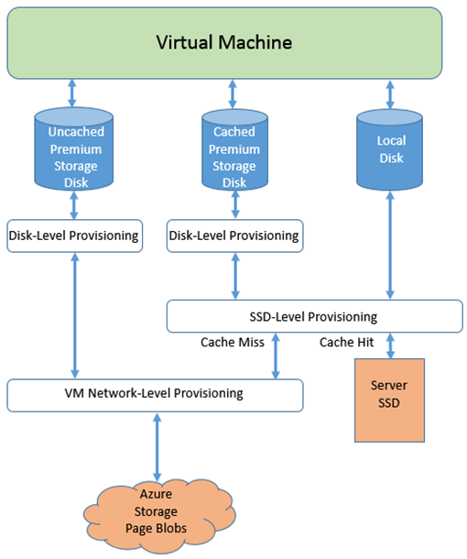
Cached v Uncached Storage (And Throttling)
Best Practise https://docs.microsoft.com/en-us/azure/virtual-machines/windows/sql/virtual-machines-windows-sql-performance
https://blogs.technet.microsoft.com/xiangwu/2017/05/14/azure-vm-storage-performance-and-throttling-demystify/

Slide 14
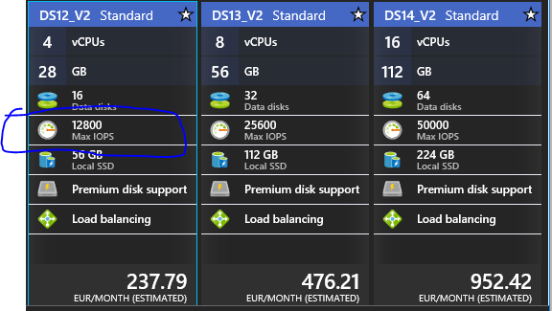
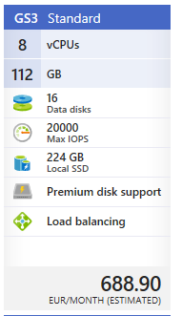
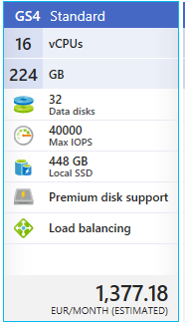
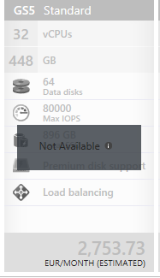
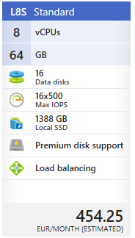
VM IOP Limits

Slide 15
How VM Type and Size affects Storage
DSv2-Series, ACU: 210-250
Cores | RAM | VM “IOPS” | Max MB/sec | Effective IOPS@64k | VM Cost €/Month
2 | 14 | 6,400 | 96 | 1,536 | 119
4 | 28 | 12,800 | 192 | 3,072 | 237
8 | 56 | 25,600 | 384 | 6,144 | 476
16 | 112 | 50,000 | 768 | 12,288 | 954
20 | 140 | 64,000 | 960 | 15,360 | 1,190
48 MB/Sec per core
GS-Series, ACU: 180 - 240
2 | 28 | 5,000 | 125 | 2,000 | 439
4 | 56 | 10,000 | 250 | 4,000 | 878
8 | 112 | 20,000 | 500 | 8,000 | 1,757
16 | 224 | 40,000 | 1,000 | 16,000 | 3,514
32 | 448 | 80,000 | 2,000 | 32,000 | 6,267 (14,493 with EE)
62.5 MB/Sec per core
https://docs.microsoft.com/en-us/azure/storage/storage-scalability-targets
https://docs.microsoft.com/en-us/azure/virtual-machines/windows/sizes-general
Notes:
€1.23 euro per MB/Sec

Slide 16
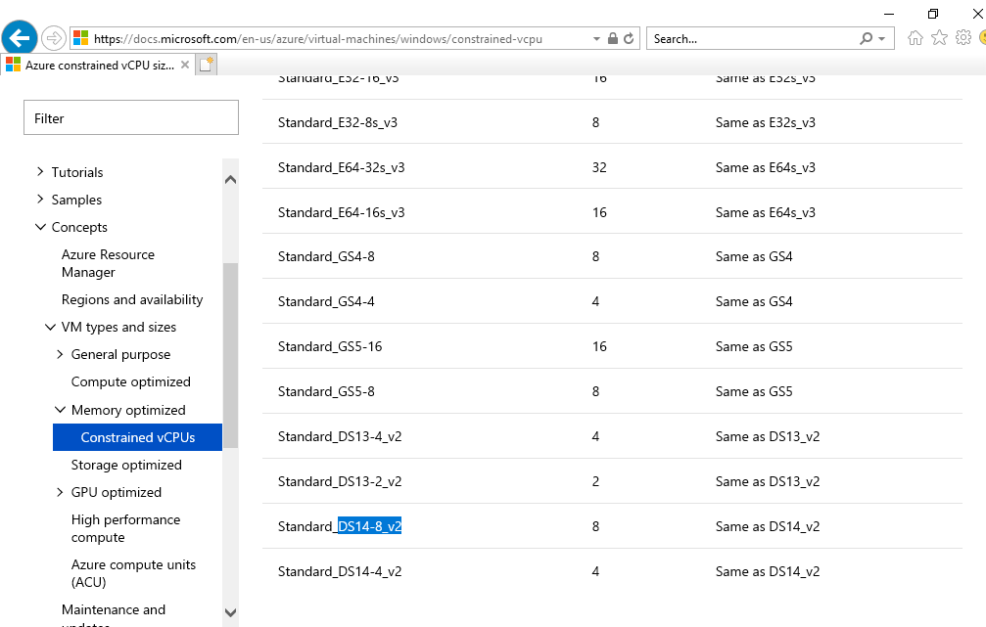
Introducing SQL Optimised VMs
Aka constrained vcpu’s
https://docs.microsoft.com/en-us/azure/virtual-machines/windows/constrained-vcpu

Slide 17
Using Storage Limits to place SQL components
VM DS14-4 v 2 (16 Core Template Constrained to 4 Cores)
Uncached (768 M/Sec)
cached (576 M/Sec)
Page Blob Disks
Page Blob Disks
Local SSD
SQL Data 600 MB/Sec
SQL Log
156 MB/Sec
TempDB
312 MB/Sec

Slide 18
3. Select Disks
4. Configure Disks
3. Select Disks
1. Requirements
5. Benchmark
2. Select VM

Slide 19
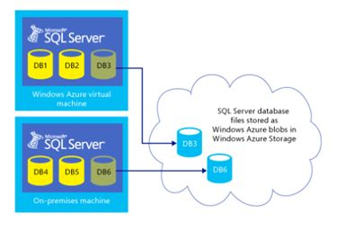
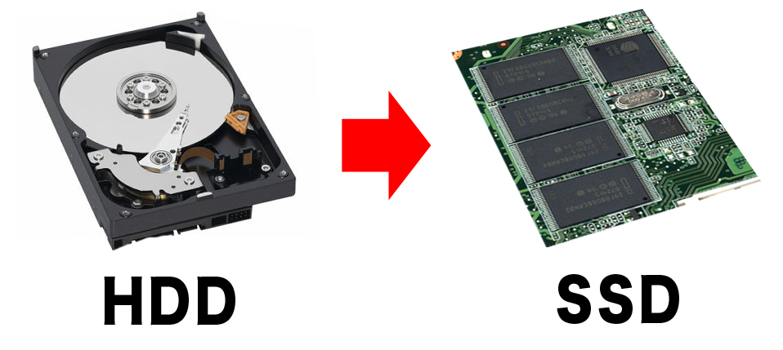
Storage Choices for IaaS ?
 | VHD on HDD | VHD on SSD | Direct to Blob Store
Throughput MB/Sec | 60 | 7-250 | 60
Max IOPS | 500 | 7,500 | 500
Latency | 10-40ms | <5ms | ???
Cost per TB/Month € | 17.28 | 113.99 | 17.28
VM SLA | None | 99.9% | None
https://azure.microsoft.com/en-us/support/legal/sla/virtual-machines/v1_6/
Notes:
CREATE DATABASE MyAzureDB
ON
( NAME = MyAzureDBData,
FILENAME = 'https://[url]/sqldata/azureData.mdf' )
LOG ON
( NAME = MyAzureLog,
FILENAME = 'https://[url]/sqldata/azureLog.ldf')

Slide 20
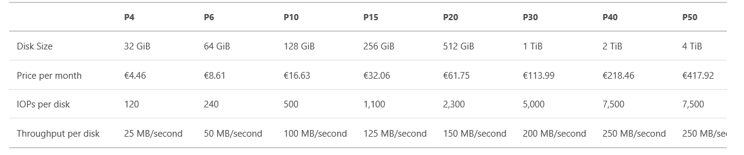
SSD Disks
https://azure.microsoft.com/en-us/pricing/details/managed-disks/
Notes:
P10 is only 8 MB/Sec

Slide 21
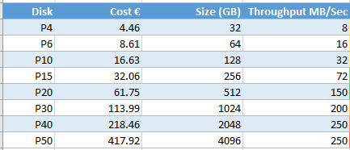
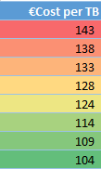
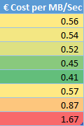
SSD Disks
https://azure.microsoft.com/en-us/pricing/details/managed-disks/
Notes:
P10 is only 8 MB/Sec

Slide 22
SSD Disks
Bottleneck @64k
 | P10 |  | P20 | P30 | P50 (new)
Disk Size (GB) | 128 |  | 512 | 1TB | 4TB
IOPS | 500 |  | 2,300 | 5,000 | 7,500
Throughput | 100 |  | 150 | 200 | 250
Effective Throughput | 8 |  | 143 | 200 | 250
Cost €/month | 18 |  | 68 | 125 | 455
Cost € per MB/Sec | 2.25 |  | 0.46 | 0.625 | 1.82
Cost € per TB | 144 |  | 136 | 125 | 114
https://azure.microsoft.com/en-us/pricing/details/managed-disks/
Notes:
P10 is only 8 MB/Sec

Slide 23
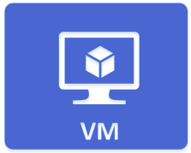

Balancing Disk and Managed Storage
STORAGE ACCOUNT 20,000 iops or 1,250 MB/Sec
VM-SQL1
VM-SQL2
Uncached Storage 768 MB/Sec
Cached Storage
564 MB/Sec
1TB SSD 200 MB/Sec
1TB SSD 200 MB/Sec
X 4
X 3

Slide 24
4. Configure Disks
4. Configure Disks
3. Select Disks
1. Requirements
5. Benchmark
2. Select VM

Slide 25
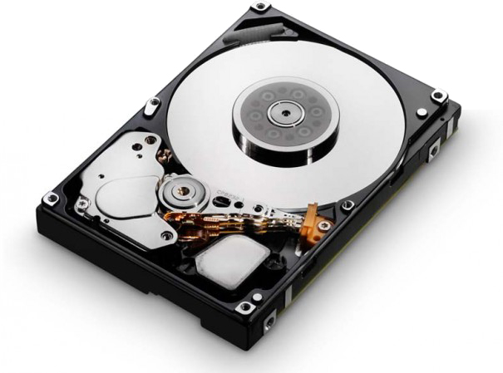
Combining Disks with Storage Spaces
Storage Pool
Just a JBOD Collection of Disks.. Individual disks can be cached or un-cached
SqlData
Layout: simple (Mirror, Parity)
Number of Columns 8= Number of physical disks per write (aka stripe)
Interleave 256KB= Size of read/write to a disk (eg I/O Size)
SqlLog
Layout: Simple
Columns=8
Interleave=64k
Virtual Disks
F:\ (SqlData), or mount point
Format: 64k (4k default)
L:\ (SqlLog)
Format: 64k
Volume

Slide 26
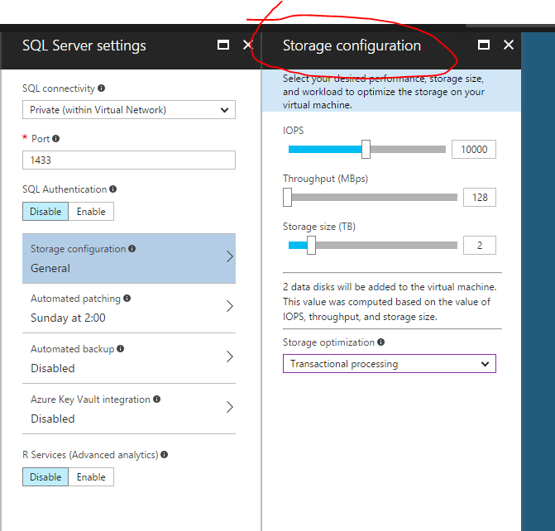
Azure Portal Storage Configuration Wizard
Advice: configure the disks yourself

Slide 27
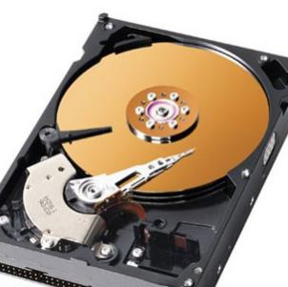


Example PowerShell
Adding disks to VMs
$diskConfig = New-AzureRmDiskConfig -AccountType $storageType -Location $location -CreateOption Empty -DiskSizeGB $diskSizeGB
$vm = Add-AzureRmVMDataDisk -VM $vm -Name $myDiskName -CreateOption Attach -ManagedDiskId $dataDisk1.Id -Lun $i
Creating storage spaces
New-StoragePool –FriendlyName SQLVMStoragePool2 –StorageSubsystemFriendlyName "Windows Storage*" -PhysicalDisks (Get-PhysicalDisk -CanPool $True)
New-VirtualDisk -StoragePoolFriendlyName SQLVMStoragePool2 -FriendlyName SQLVMVirtualDisk2
-Interleave 256KB -NumberOfColumns 1 -UseMaximumSize -ResiliencySettingName simple

Slide 28

The Data and Log Debate
\SqlData \SqlLog
Same Volume (Same disk and pool)
Data
Log
2 Separate Volumes (Same disk and pool)
Data
Log
3. Separate Virtual Disks and Volumes (Different Interleave…)
Data
Log
Data
Log
4. Separate Pools, Disks and Volumes
Data
Log

Slide 29
5. Benchmark
4. Configure Disks
3. Select Disks
1. Requirements
5. Benchmark
2. Select VM

Slide 30
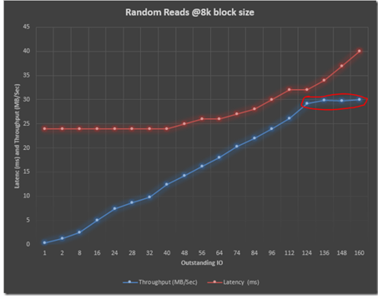
Benchmarking
Use diskspd.exe to validate throughput and or IOPS
Consider making a IO saturation chart
Run diskspd as ever increasing thread and outstanding IO
If you are lazy use CrystalDiskMark
http://blogs.prodata.ie/post/IOPS-Planning-for-SQL-Server-in-Azure-IaaS.aspx

Slide 31
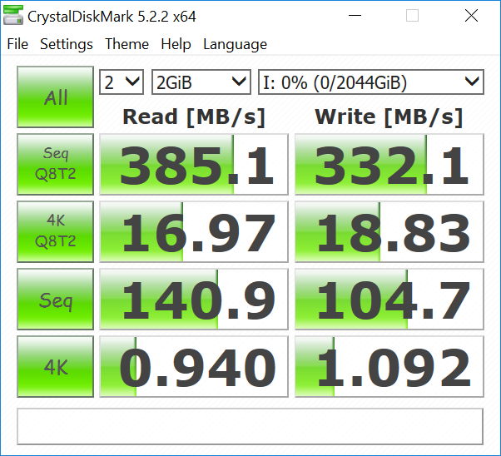
8 Core Uncached 2 x P30

Slide 32
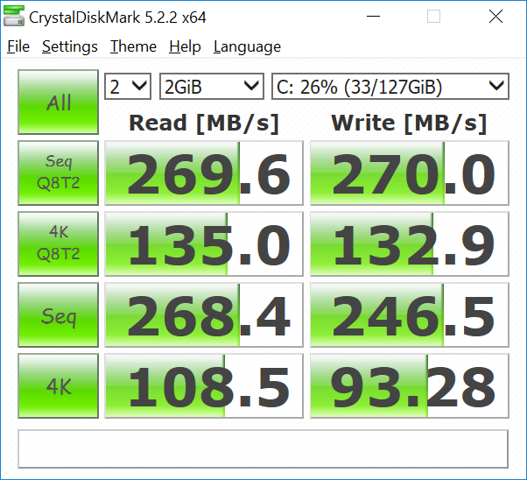
8 Core cached 2 x P30

Slide 33
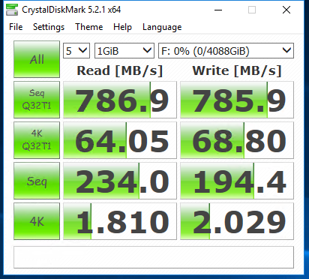
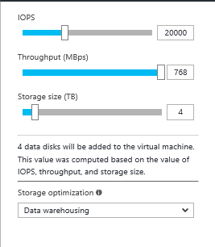
16 Core VM – 4 x 1TB disks

Slide 34
Bonus Content Abusing the Rules

Slide 35
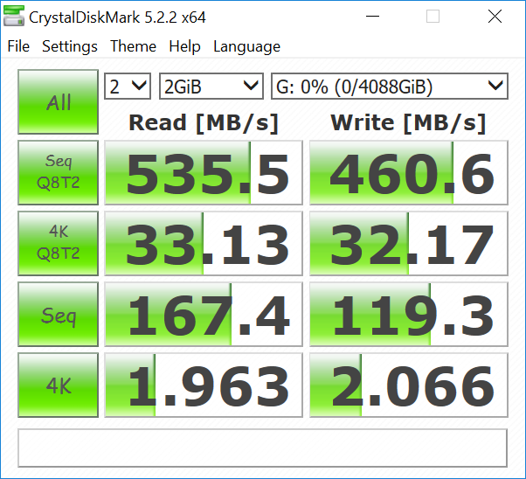
Abusing the Rules for max table scan
8 core DS VM
376 MB/Sec max Uncached
288 MB/Sec max cached
Place data on BOTH pools

Slide 36
Lessons Learned
Worry more about throughput than IOPS
Choose your own disks to get target throughput
Build your own disk pools in storage spaces
Plan your VM Size based on capacity planning

Slide 37
Wish List for SQL IaaS in Azure
Provisioning IOPs.
Give me 2GB/Sec on my 1TB of data
Don’t make me scale ram and everything else
Smoother TempDB Configuration
Better SQL Storage Configuration Wizard

Slide 38







A BIG thank you to Dublin Sponsors!

Slide 39





A BIG thank you to the 2018 Global Sponsors!

Slide 40

XBOX & OTHER PRIZES… FILL IN THE FORM!
https://aka.ms/azurebootcampireland

Slide 41
Bonus Content Designing for Elasticity Maxing the Rules

Slide 42
Designing storage for elasticity
We need a 3TB SQL but want to “max” storage performance on an 8 core server and burst up to 20 core at night
8 Core VM
384 MB/Sec
1TB SSD 200 MB/Sec
1TB SSD 200 MB/Sec
1TB SSD 200 MB/Sec
600 MB/Sec
20 Core VM
960 MB/Sec
512GB SSD 150 MB/Sec
X 6 = 900 MB/Sec

